Slide 1
Elettromeccanica Bonato
Industrial Antistatic Devices

Slide 2
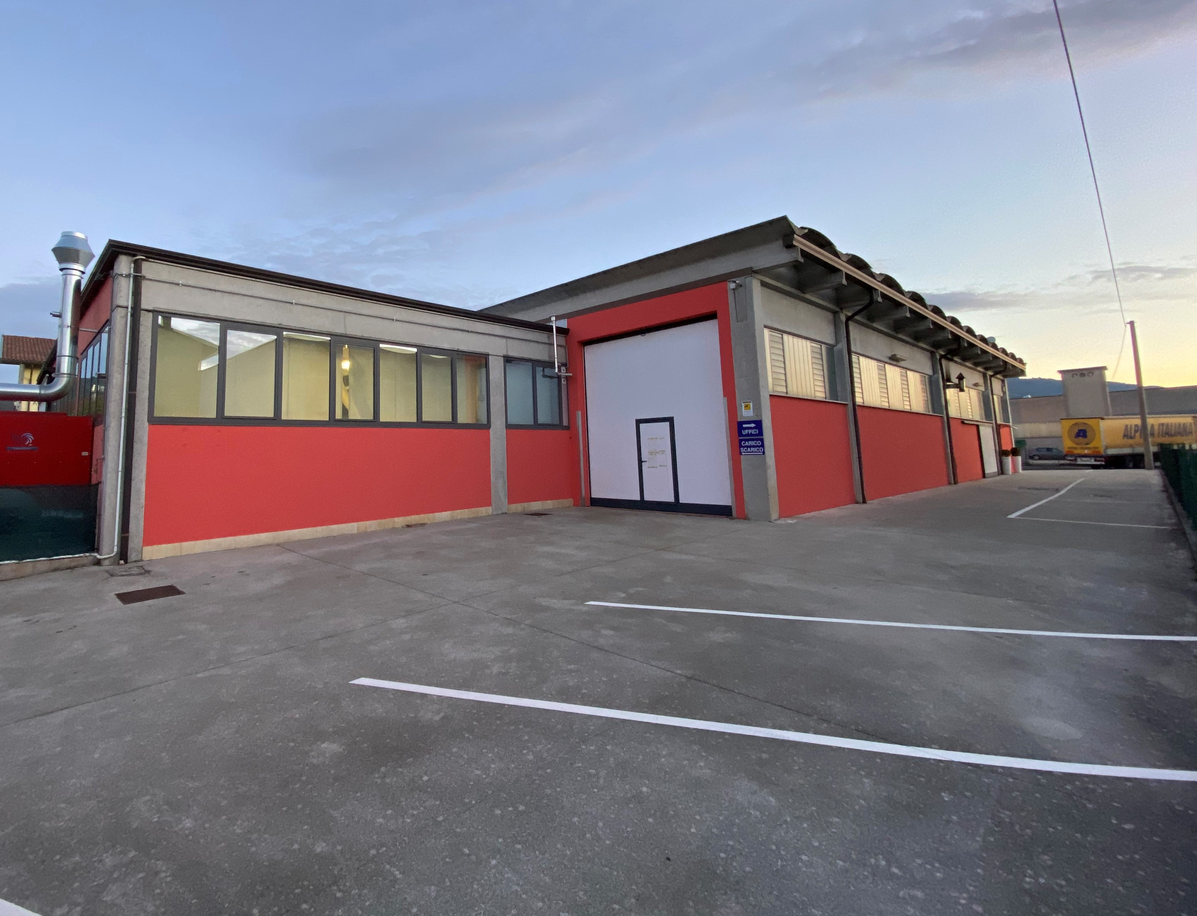
Since 1978
Founded by Mr. Ermenegildo Bonato, Electrical Engineer, Elettromeccanica Bonato has over 40 years of activity in designing and manufacturing devices for eliminating or reducing problems caused by static electricity
The registered office and production unit are located in Carrè (province of Vicenza), for a total surface of 800 square meters, where 10 people are employed full-time, products are exported to over 50 countries worldwide and the company’s turnover is approximately 2.000.000,00 Euros

Slide 3
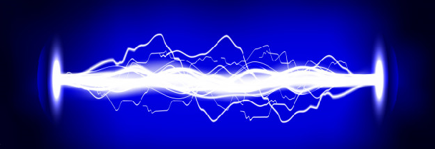
EFFECTS OF ELECTROSTATIC CHARGES
Electrostatic charges cause many troubles, as attracting dust and other foreign materials; during the processing phases that material adheres to some machine components, forcing the company to suspend production and carry out all the necessary operations for not spoiling the product
Electrostatic charges can be dangerous as they trigger potentially harmful discharges for electrical and electronic equipment and can cause fires, explosions or even injure people
Static electricity can also be deliberately generated and controlled to improve quality and increase productivity
To neutralize or eliminate electrostatic charges, it is necessary to ionize the air surrounding the charged body, breaking down the air atoms into positive ions (free nuclei) and negative ions (free electrons)
While opposite charges attract each other, a negatively charged body will attract positive ions and produce its negative ions until it becomes neutral, while a positively charged body will attract negative ions to become neutral

Slide 4
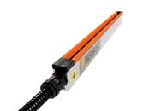
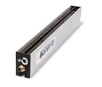
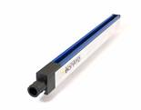
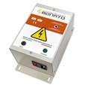
PRODUCTS AND APPLICATIONS
The company Elettromeccanica Bonato, ISO 9001 certified, designs and manufactures systems for controlling electrostatic current, also with ATEX marking
Its range includes charge and discharge bars, antistatic guns, nozzles, blowers and fans, antistatic power supplies and generators, carbon fiber brushes, edge holders and fixing heads
There are many industrial processes that require antistatic equipment, among others: packaging and transport lines, textile finishing processes, rotogravure and rotoflex printing machines, labeling machines, packaging machines, cutters and rewinders, plastic injection lines and film blowing, corona and plasma surface treatments, woodworking lines (lamination), painting plants

Slide 5
Elettromeccanica Bonato s.a.s. Via Rostoncello 25/B, 36010 Carrè (VI), Italy ' +39 0445 368178
https://elettromeccanicabonato.it
sales@elettromeccanicabonato.it
https://www.directindustry.it/prod/elettromeccanica-bonato-sas-196677.html

